Slide 1
Pattern Creator Simon Widmann

Slide 2
Problem
ECP limited to simple shapes
Small file sizes required
Idea
Draw arbitrary geometrical shapes
Shapes represented as parametrizations of closed curves
Use low amount of rectangles to fill the shapes
Implement as an easy to use Python package

Slide 3
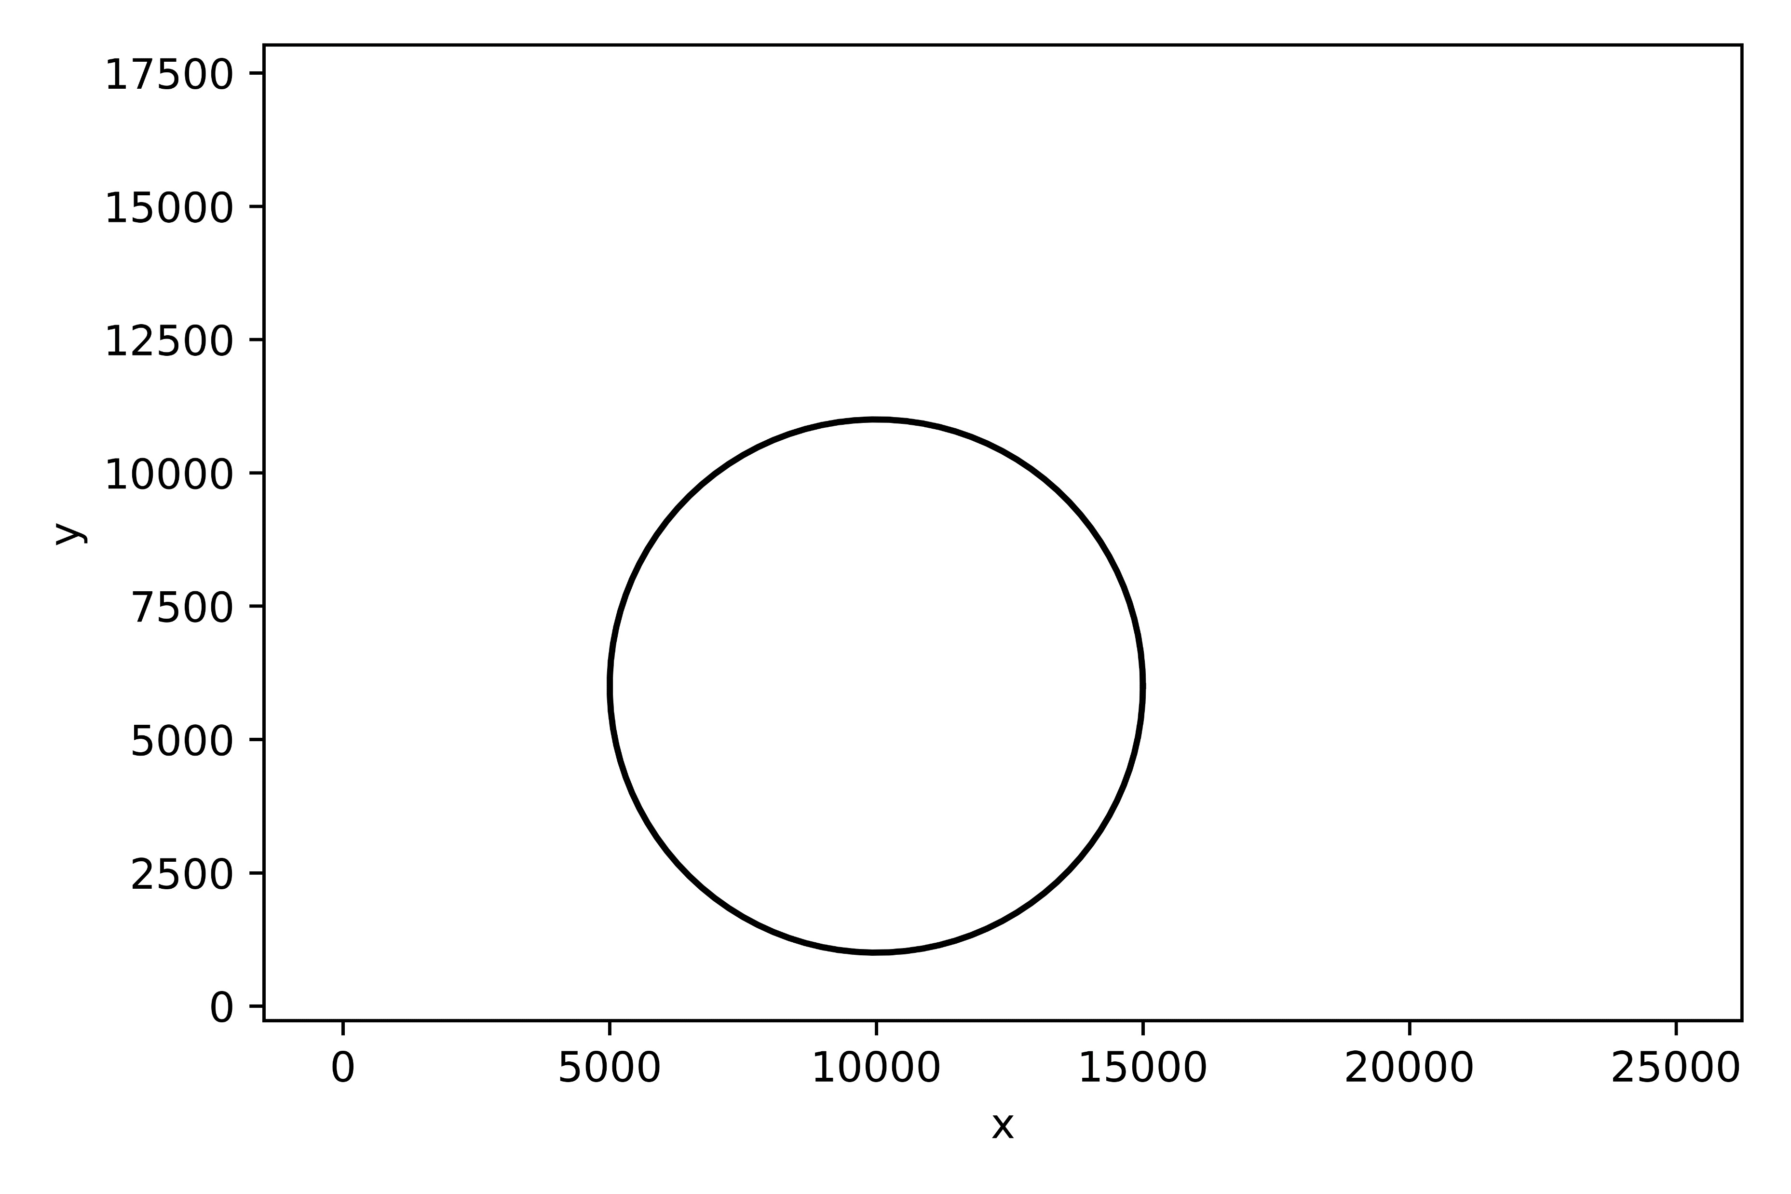
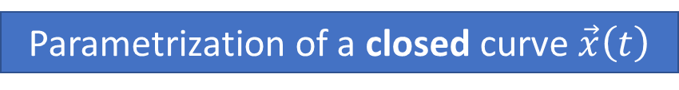

Definition of shapes
Parametrization of a closed curve $\vec{x}\left(t\right)$
Example:
$${\vec{x}}_{Circle}\left(t\right)=\left(\begin{matrix}x_{0}+r⋅\cos\left(2πt\right) \\ y_{0}+r⋅\sin\left(2πt\right)\end{matrix}\right)$$
with $t∈[0, 1)$.

Slide 4
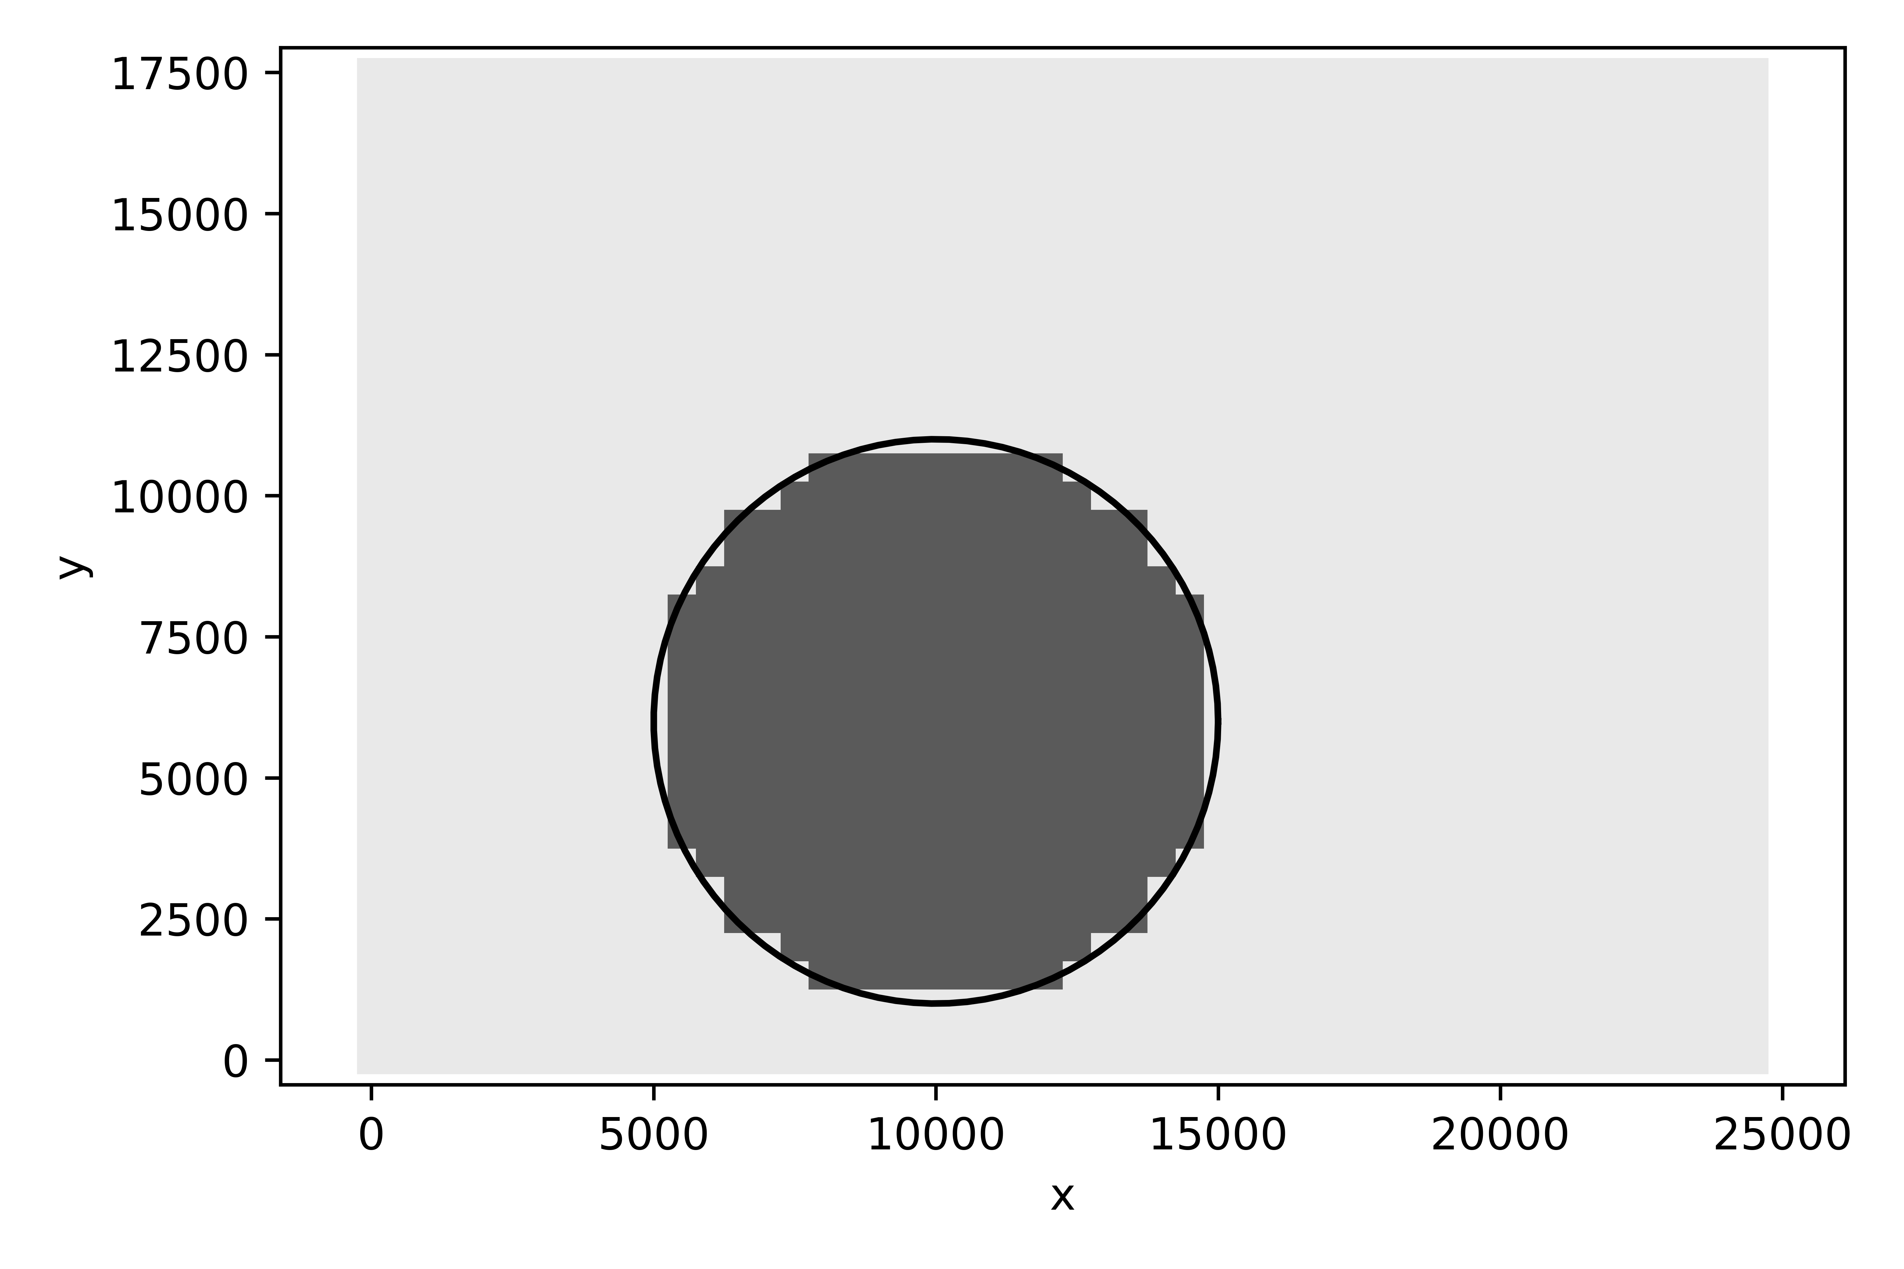
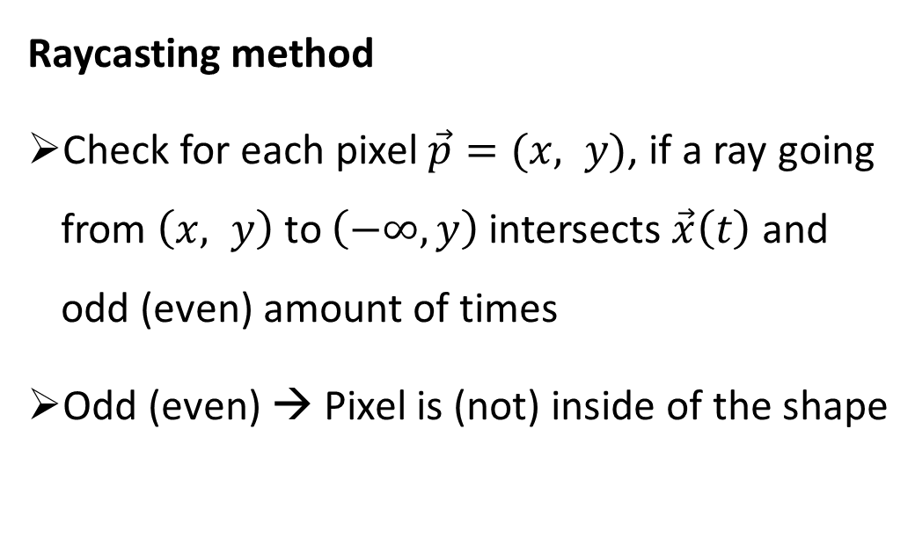
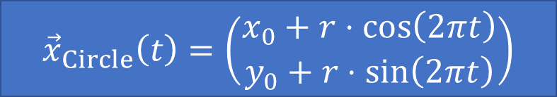
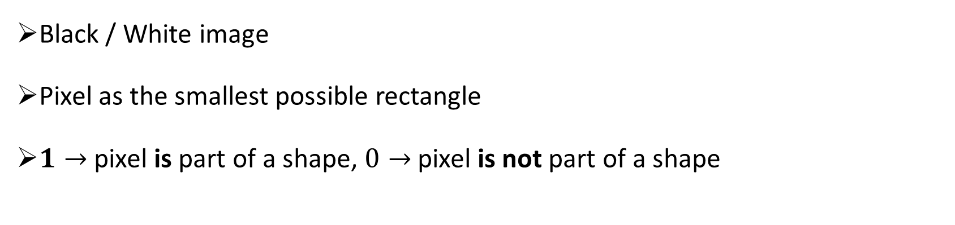
Translation of the shape into pixels
Black / White image
Pixel as the smallest possible rectangle
$1→$ pixel is part of a shape, $0→$ pixel is not part of a shape
$${\vec{x}}_{Circle}\left(t\right)=\left(\begin{matrix}x_{0}+r⋅\cos\left(2πt\right) \\ y_{0}+r⋅\sin\left(2πt\right)\end{matrix}\right)$$
Raycasting method
Check for each pixel $\vec{p}=(x, y)$, if a ray going from $\left(x, y\right)$ to $\left(−∞, y\right)$ intersects $\vec{x}\left(t\right)$ and odd (even) amount of times
Odd (even) → Pixel is (not) inside of the shape
Notes:
Shape -> rectangles

Slide 5
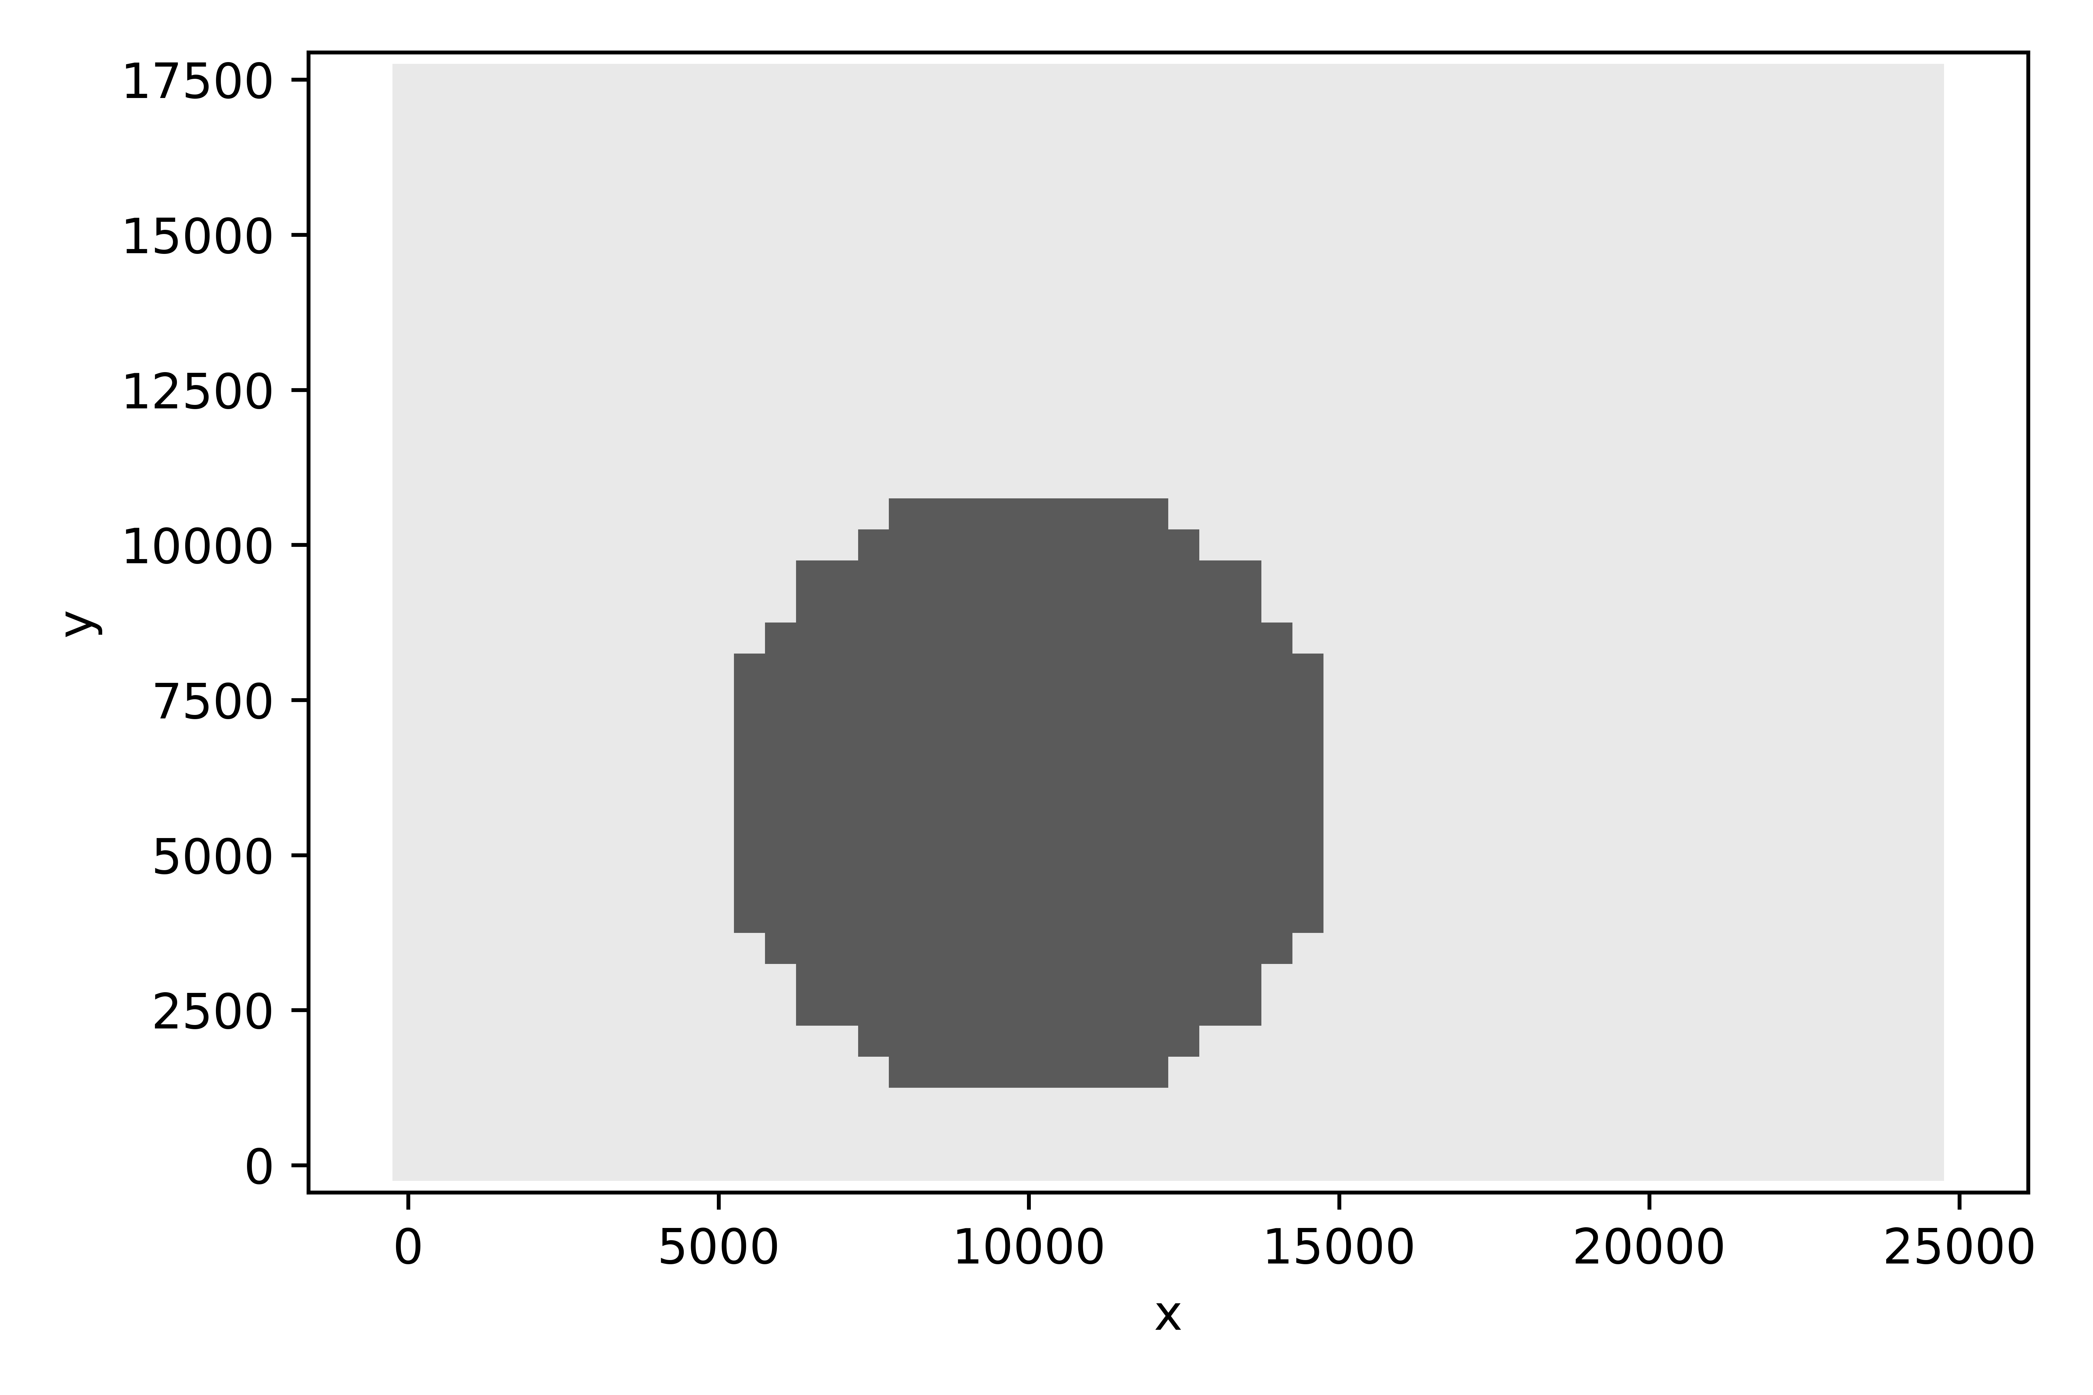
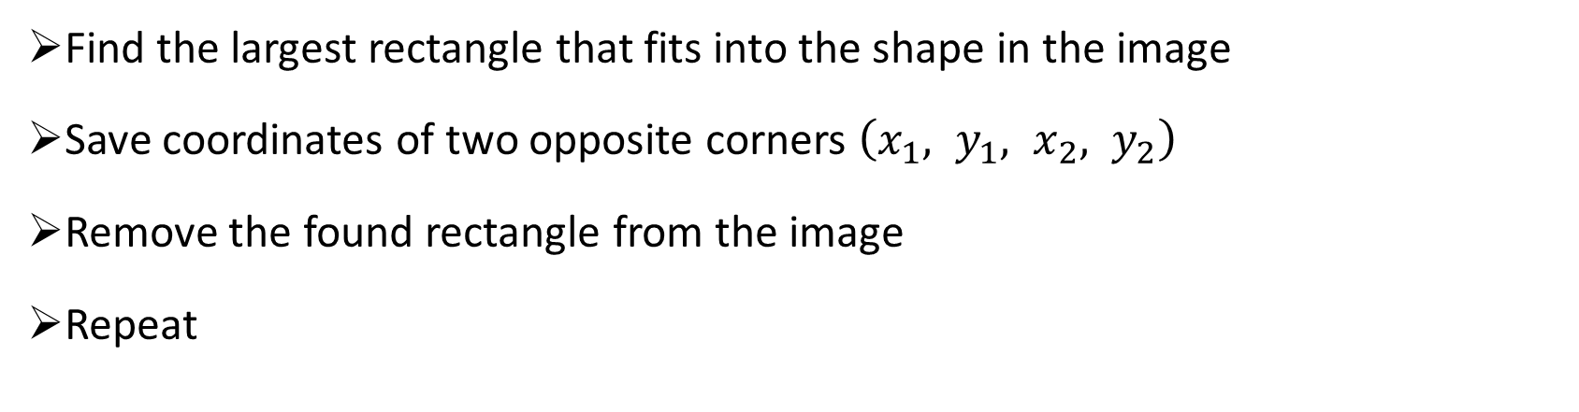


Grouping pixels into larger rectangles
Find the largest rectangle that fits into the shape in the image
Save coordinates of two opposite corners $\left(x_{1}, y_{1}, x_{2}, y_{2}\right)$
Remove the found rectangle from the image
Repeat
$$\left(x_{2}, y_{2}\right)$$
$$\left(x_{1}, y_{1}\right)$$

Slide 6
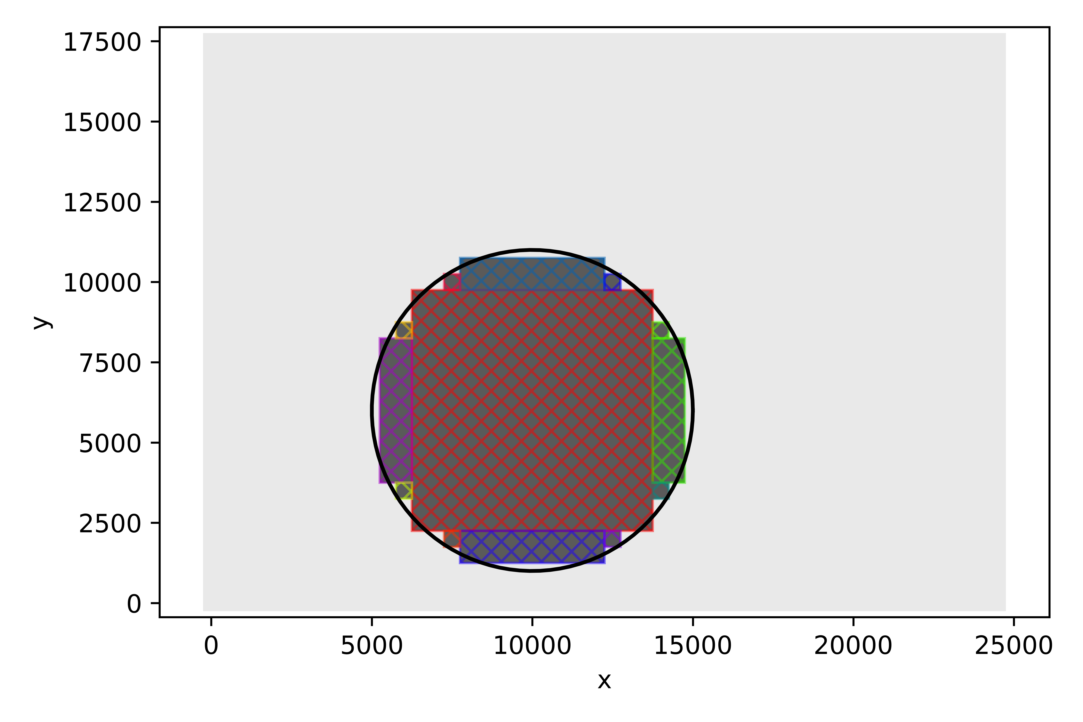
Grouping pixels into larger rectangles
Repeat until no pixel is left
Convert rectangle corner coordinates into ECP code
ECP .pat code
RECT 6250, 2250, 13750, 9750
RECT 5250, 3750, 6250, 8250
RECT 7750, 1250, 12250, 2250
RECT 7750, 9750, 12250, 10750
RECT 13750, 3750, 14750, 8250
RECT 5750, 3250, 6250, 3750
RECT 5750, 8250, 6250, 8750
RECT 7250, 1750, 7750, 2250
RECT 7250, 9750, 7750, 10250
RECT 12250, 1750, 12750, 2250
RECT 12250, 9750, 12750, 10250
RECT 13750, 3250, 14250, 3750
RECT 13750, 8250, 14250, 8750

Slide 7
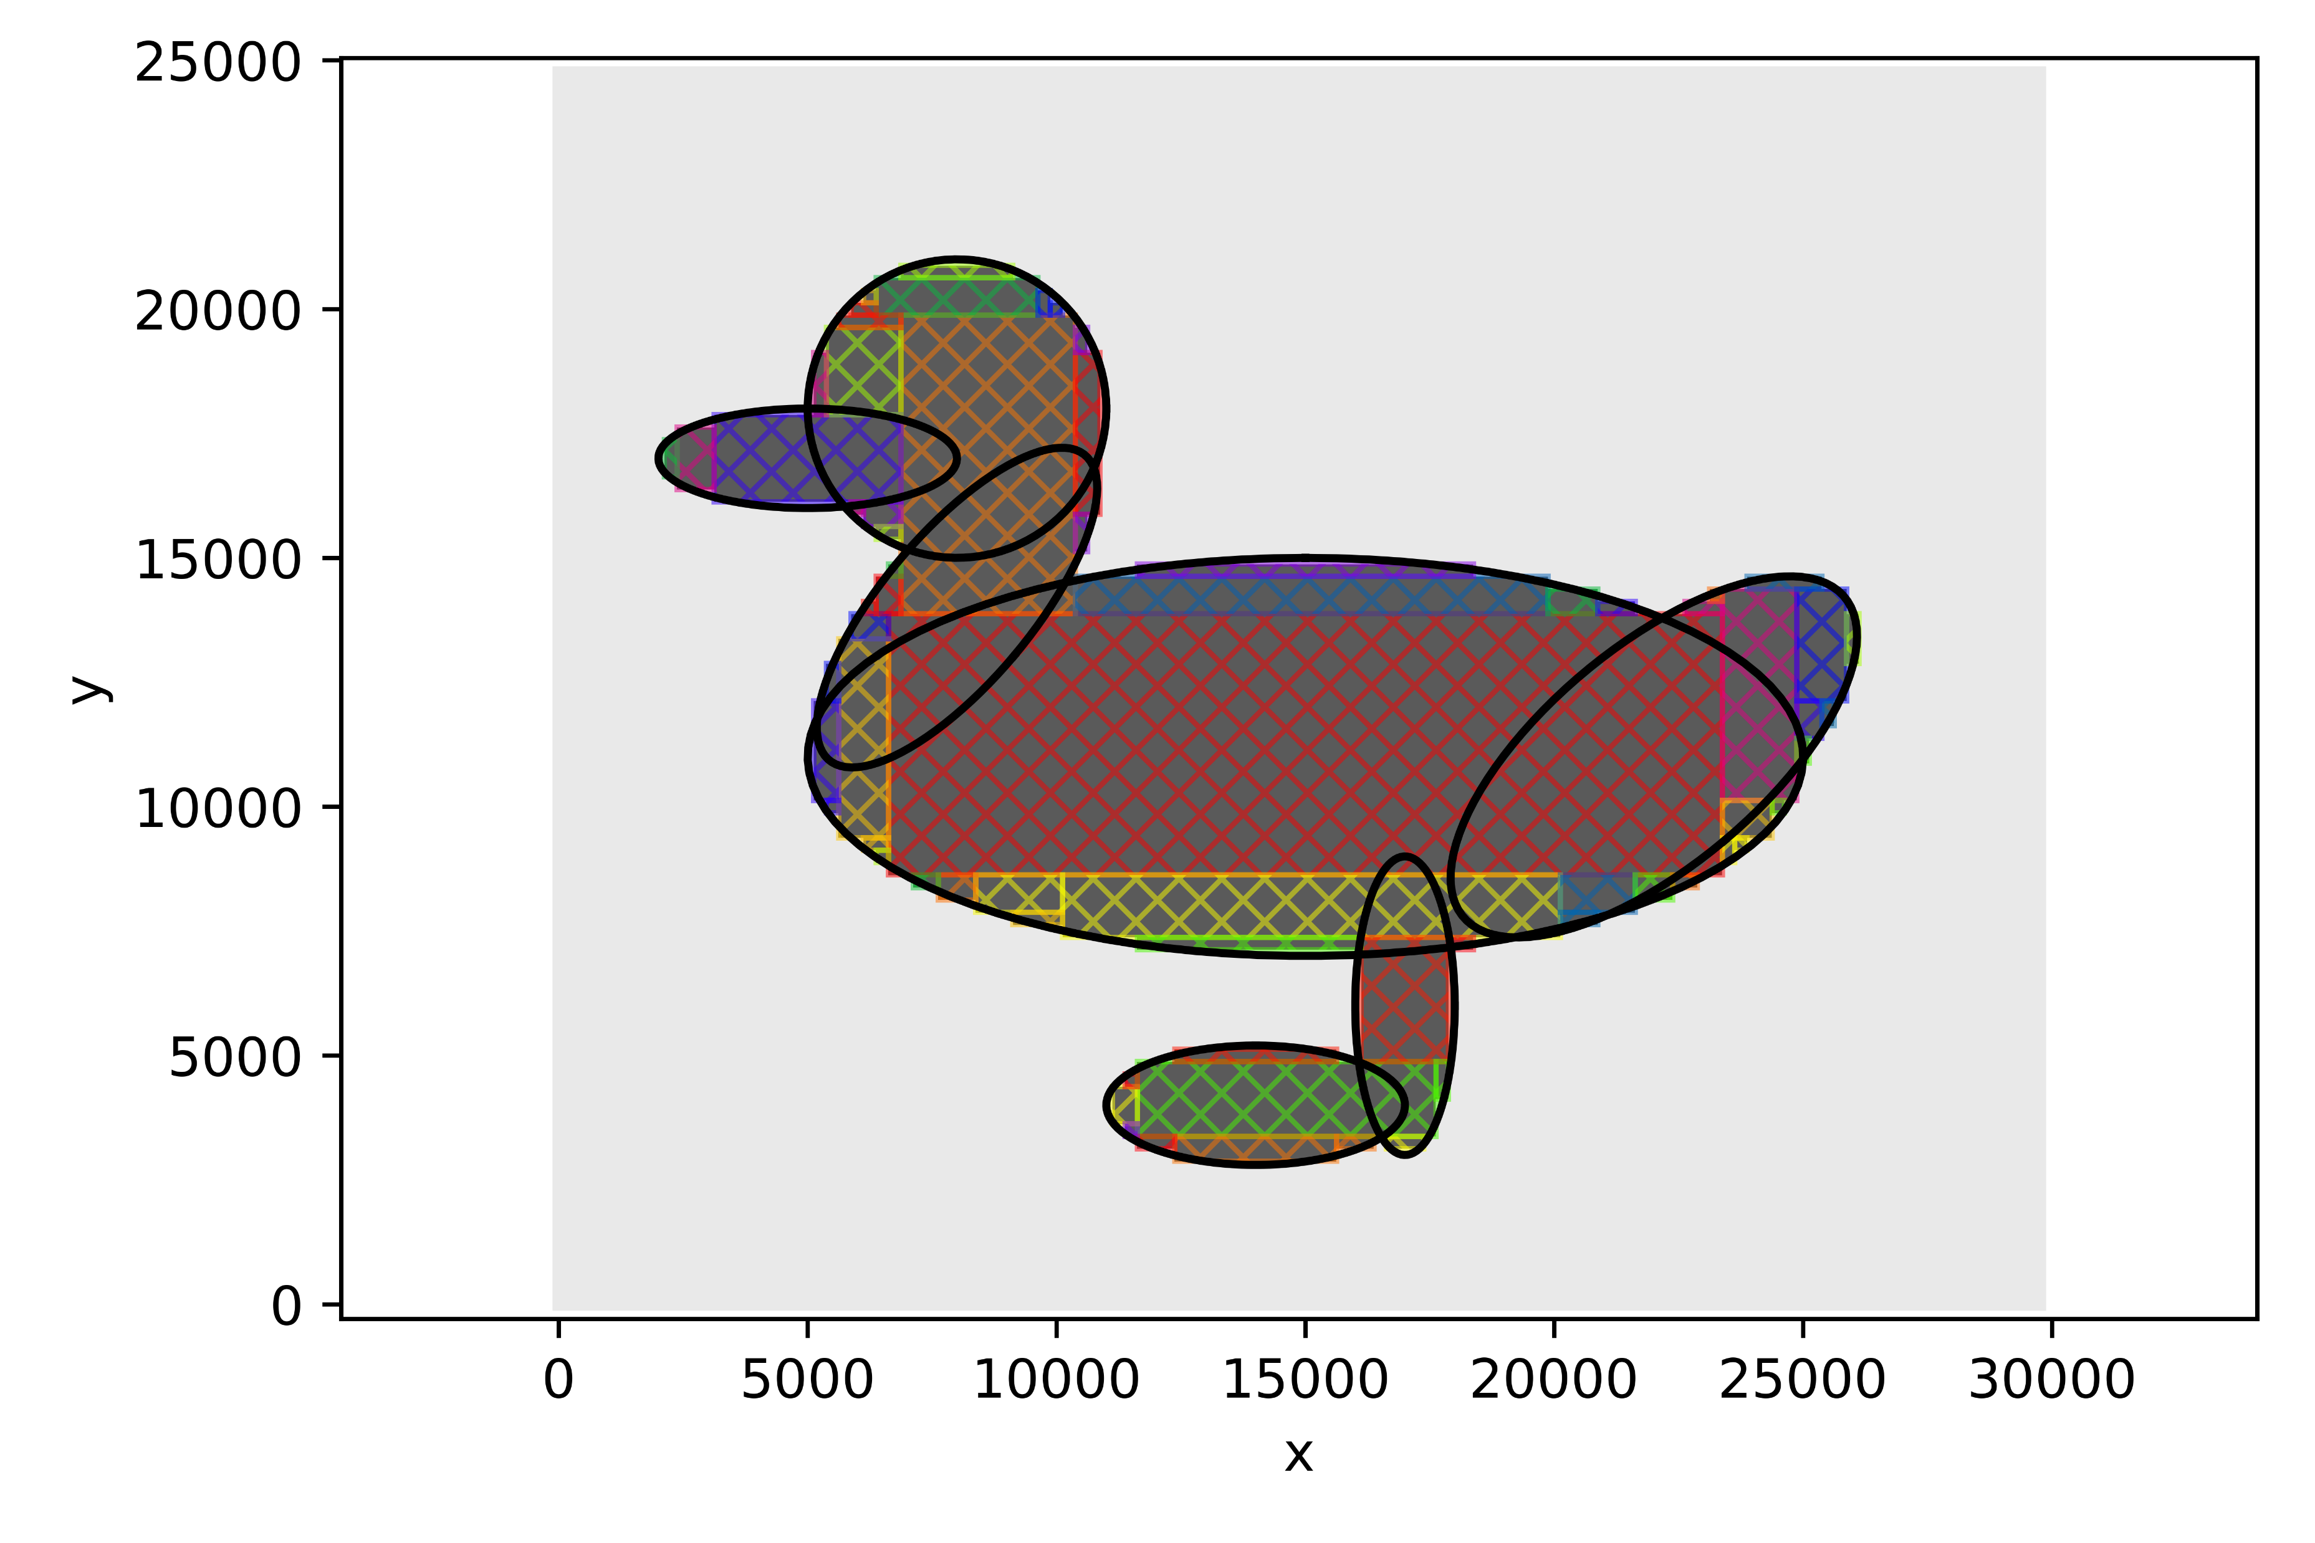
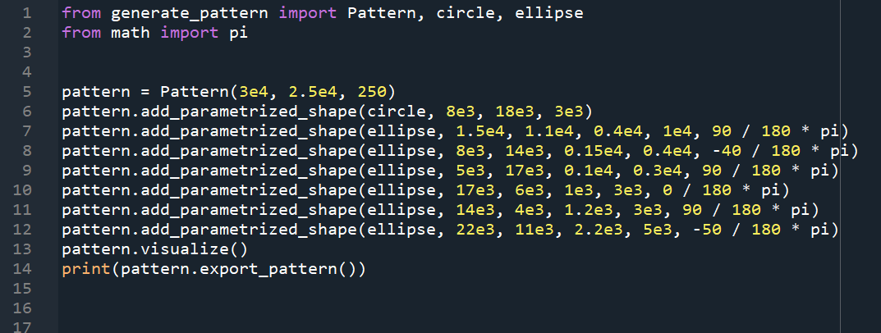
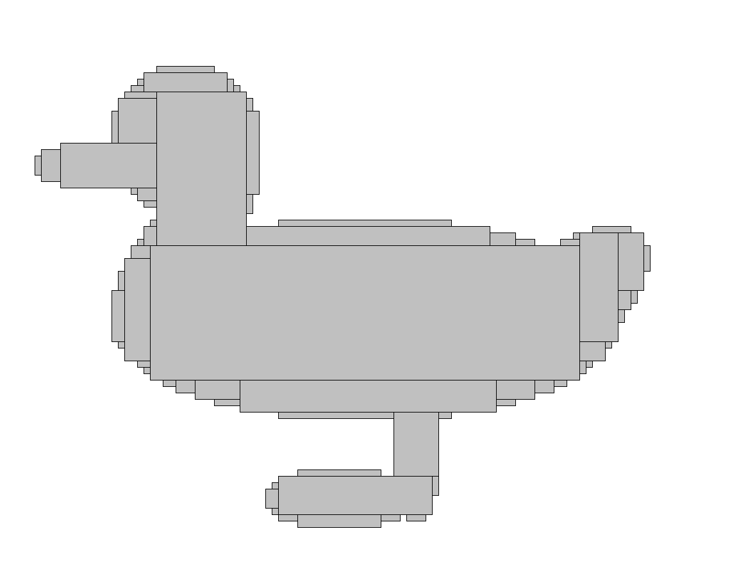
More complicated shapes
Combination of multiple curves
Overlap is automatically supported
Higher resolution with fast computation time
Short code:
ECP:
duck.pat

